Slide 1
Managing Information Technology Resources ITWS 4310
Technology, Strategy and Projects
September 6, 2018

Slide 2
Managing IT Resources Class Outline: Thurs, Sept 6, 2018
Project Team Assignments
Project Teams submit Term Project Proposals on Thurs Sept 13 by EOD (11:59 PM)
Kahoot “Quiz” on Class Intro, Ch 1, Ch 2, Current Events
Current Event Articles
Chapter 1: Technology and Modern Enterprise
Chapter 2: Strategy and Technology
Assignments for Week 3
Meet with Project Teams about Project Selection

Slide 3
Managing IT Resources Faculty Contact and Office Hours
Matthew Grill: mgrill.rpi@gmail.com
Office – Lally Hall 315
Office Hours – Tuesdays 11 AM – Noon
Jeff Miner: minerj@rpi.edu
Office – Folsom Library Room 233A
Office Hours – By appointment
Gaurang Prasad: prasag@rpi.edu
Office – ITWS Lounge (Lally 205)
Office Hours – Wednesdays 10 AM – Noon

Slide 4
Managing IT Resources: ITWS 4310 Textbook and Coursepack
John Gallaugher. Information Systems: A Manager's Guide to Harnessing Technology, v. 7.0, Flat World Knowledge. E-ISBN: 978-1-4533-9404-5. Textbook is available in both electronic and print versions at: https://students.flatworldknowledge.com/course/2586758 .
The articles and business cases required for the course are available from Harvard Business School Press via credit card purchase a: to be provided
Other supplemental materials will be from the web or available via LMS

Slide 5
MITR Syllabus Outline: Communication
In addition to classroom participation, this course will use Slack to foster continued participation and collaboration outside of the classroom. Each student must create an account and be part of the group discussion channels at a minimum (to be sure they are not missing any announcements, etc. that may be posted through these channels). While further, active use of the channels is not mandatory, it is recommended. Each team will also be provided with a private channel for their use related to their term project. Again, active use and participation in the private team channel is not mandatory but it is recommended.

Slide 6
MITR Syllabus Outline: Communication
Notes on Slack:
Channel name: itws-mitr.slack.com
Please use your full name (First & Last) as it appears in SIS when signing up.
Please use your RPI e-mail address when signing up.
Please use the following link to join: https://join.slack.com/t/itws-mitr/shared_invite/enQtNDI1ODU5NjI2MTE3LWU4M2IzNTEzMTIyMTczYTgwOGFmMWEzYTM4OTNiMTMyY2NiMGFiZTA2N2I3Nzc0YjBiOWM4ZDY3MzVkMGVlMzM

Slide 7
MITR 2018 Term Project Teams & Seating Chart
Row 4
Row 3
Row 2
Row 1
Front of Classroom

Slide 8
Managing IT Resources: ITWS 4310 Term Project Outline
Description:
This project requires the identification of a real organization as a “client”. Ideally, the selected organization is one for which a student is familiar in some substantial fashion. Students are in teams of three to five persons. The student team examines the organization and improves some operational or management process in this organization through an application of information technology. This project requires that a prototype system be turned over to the client for review and acceptance. It is preferable that the system is complete, installed, and turned over to the client.

Slide 9
Managing IT Resources: ITWS 4310 Term Project Report Outline
Section 1: Executive Summary
Section 2: Introduction
Section 3: Client Organization and Description
Section 4: Project Team
Section 5: Problem Statement
Section 6: IS/IT Solution
Section 7: Methodology
Section 8: IS/IT Requirements
Section 9: IS/IT Design
Section 10: Cost-Benefit Analysis
Section 11: Project Plan/Schedule/Resources
Section 12: Post-Turnover Plan
Section 13: Results and Client Feedback
Section 14: Conclusions

Slide 10
Managing IT Resources: ITWS 4310 Term Project Outline
Final Presentation: Teams will present on Dec 6 and 10. A professionally prepared presentation will be given which summarizes your report. The presentation should consist of about 10-15 slides and should take about 10 minutes to present. Each member of the team should participate as a speaker in some portion of the presentation. The Final Presentation will count 20% of the Final Project Grade. Within this 20%, all students will evaluate and rank-order all other teams’ project presentations. The average of the students’ rank order will count 10% of the Final Project Grade and the instructor’s evaluation will count 10% of the Final Project Grade.

Slide 11
Managing IT Resources: ITWS 4310 Term Project Outline
Team Member Peer Reviews: Each team member will evaluate the contribution of all of their team’s members. This peer review will be confidentially provided to the instructor only. It will be used to adjust the individual student’s Final Project Grade. The individual student’s grade adjustment will be a maximum of plus or minus 10% points of the team’s Final Project Grade. The resulting average of the all team members’ Final Project Grade will equal to the team’s Final Project Grade.

Slide 12
Client/Project Criteria
Client must be “real”; can be a company, a non-profit organization, government agency, sole proprietorship, etc.
Project must involve implementing an information system or technology solution that addresses a business need for the client.
Scope must be more than just a web presence; can include database, content management, data analytics, hardware, process reengineering, workflow automation, etc.
Client and scope must be approved by an instructor

Slide 13
MITR Term Projects
What are some criteria for a successful project?

Slide 14
Past criteria for a successful project

Slide 15
Meet Your Team!
Take 10 minutes to meet with your team
Exchange contact information
Discuss availability
Discuss project ideas and/or leads
Get to know each others skills, strengths, weaknesses, etc.
Remember: lots of hard work, commitment, dedication
Remember: RESPECT

Slide 16
Kahoot! “Quiz”
Go to kahoot.it to join
Enter the Game PIN from the screen
https://create.kahoot.it/

Slide 17
Technology Current Events: New York Times, September 4, 2018 https://www.nytimes.com/2018/09/04/technology/amazon-stock-price-1-trillion-value.html
Amazon Hits $1,000,000,000,000 in Value, Following Apple:
When Apple’s market value crossed a trillion dollars last month, the reason was simple: It makes devices that a lot of people are willing to spend a lot of money on.
Now Amazon has become the second American company to cross that once-unimaginable line. Its shares rose as high as $2,050.50 on Tuesday morning, pushing it over $1 trillion in value, before immediately falling back and then ending the day at $2,039.51, below the $1 trillion threshold. Amazon’s founder and chief executive, Jeff Bezos, is worth nearly as much as Bill Gates and Warren E. Buffett put together.
This time, the explanation is more complicated.
Amazon captures 49 cents of every e-commerce dollar in the United States. It employs more than 550,000 people and generates $178 billion in annual revenue. It sells everything from computing space to peanut butter to appointments with plumbers.
But the thing it has always sold the most — to investors, customers, the news media — is excitement.

Slide 18
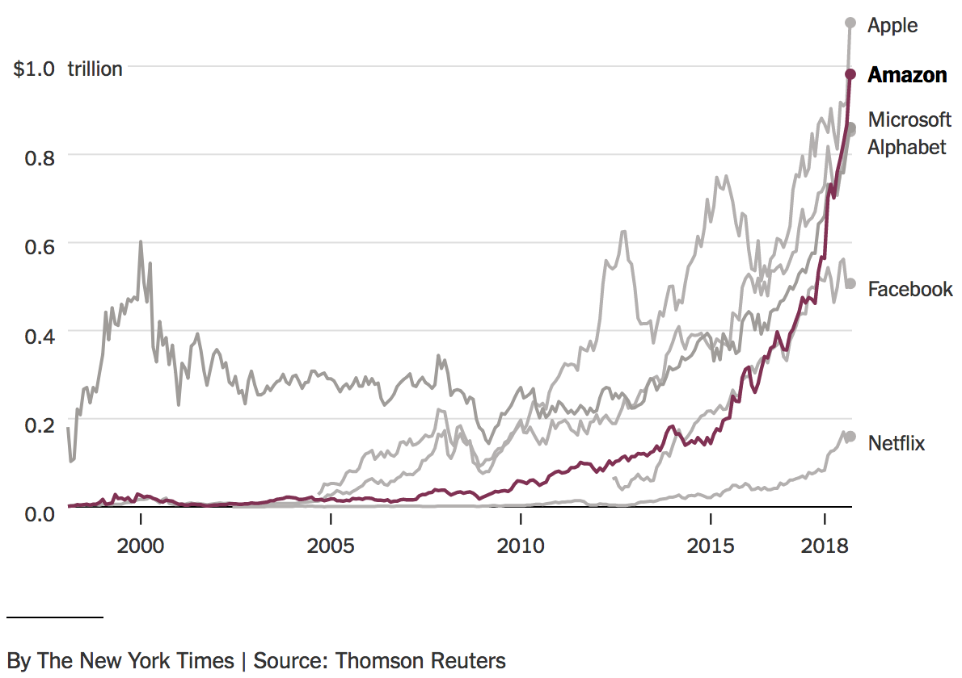
Technology Current Events: New York Times, September 4, 2018 https://www.nytimes.com/2018/09/04/technology/amazon-stock-price-1-trillion-value.html
Amazon Hits $1,000,000,000,000 in Value, Following Apple:

Slide 19
Technology Current Events: TechSpot, September 4, 2018 https://www.techspot.com/news/76255-chip-makers-slowing-down-way-7nm.html
Chip makers are slowing down on the way to 7nm:
Development costs are becoming a problem for some
Bottom line: Building even smaller transistors has gotten too expensive for the majority of design firms in the near term. Even though 7nm is now possible, only pricey chips with high performance or extraordinarily low power consumption will make use of the latest process node.
Samsung Electronics and TSMC are the only two pure-play foundries that have shared their 7nm plans. GlobalFoundries has decided to cease further development of 7nm FinFETs causing AMD to change partners. Instead of racing towards smaller nodes, GlobalFoundries is aiming to collect profits on higher margin 14nm chips that are in high demand.

Slide 20
Technology Current Events: Albany Times Union, August 31, 2018 https://www.timesunion.com/business/article/GlobalFoundries-eliminated-455-jobs-new-filings-13194735.php
GlobalFoundries eliminated 455 jobs, new filings show:
GlobalFoundries this week confirmed it would eliminate 424 jobs at its Malta semiconductor factory and another 31 based at SUNY Polytechnic Institute in Albany, filings with the state Labor Department show.
GlobalFoundries had invested $2 billion to prepare its Malta plant for 7-nanometer production, including the acquisition of several extreme ultraviolet lithography machines that cost $200 million apiece.
GlobalFoundries' withdrawal from the 7-nanometer development effort leaves two companies — Taiwan Semiconductor Manufacturing Company (TSMC) and Samsung — pursuing the leading-edge technology.
GlobalFoundries and TSMC are foundry operations, producing chips designed by semiconductor firms that don't have their own factories. TSMC had 2017 sales of nearly $32.2 billion, according to IC Insights, five times GlobalFoundries' $6.1 billion in sales.
GlobalFoundries will focus on its 14/12-nanometer chips, adding features it says will be "most relevant" to its clients, CEO Thomas Caulfield said earlier this week.

Slide 21
Chapter 1
Setting the Stage: Technology and the Modern Enterprise

Slide 22

Learning Objectives
Appreciate how, in recent years, technology has helped bring about radical changes across industries and throughout societies.

Slide 23
Technology: Changing Business Landscapes
Billions of people have access to computing and telecommunications.
Google, Twitter, and Facebook have changed the way firms advertise and people communicate.
Open source software has lowered computing costs.
Cloud computing and software has become a valuable service.
Turned high-powered computing into a utility available to even the smallest businesses and nonprofits.
While tech creates new Giants, also know that half of the Fortune 500 companies on the list in 2000 have fallen off since then as a result of mergers, acquisitions, and bankruptcies.

Slide 24
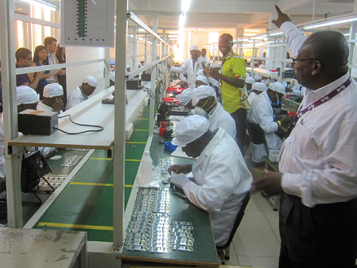
Technology: Changing Business Landscapes
New technologies have:
Fueled globalization
Redefined concepts of software and computing
Crushed costs
Fueled data-driven decision making
Raised privacy and security concerns
Example: globalization showing the success of tech in Ghana.

Slide 25
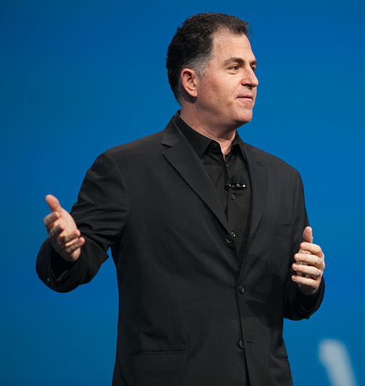
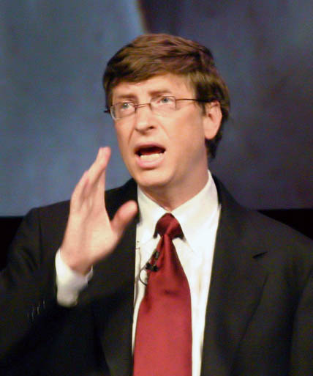
A Young People’s Revolution
Many of the world’s most successful technology firms were created by young people.
Bill Gates: Undergraduate when he left college to found Microsoft
Michael Dell: Sophomore when he began building computers at the University of Texas
Mark Zuckerberg: Nineteen-year-old sophomore when he founded Facebook
Steve Jobs: Twenty-one when he founded Apple

Slide 26
A Young People’s Revolution

Slide 27
A Young People’s Revolution

Slide 28
A Young People’s Revolution

Slide 29
A Young People’s Revolution

Slide 30
A Young People’s Revolution

Slide 31

Technology in Accounting
The reliability of any audit is tied to the reliability of the underlying technology.
Increased regulation has strengthened the link between accounting and technology.
Sarbanes-Oxley Act: Raised the executive and board responsibilities and ties criminal penalties to certain accounting and financial violations.
Major accounting firms have spawned tech-focused consulting practices.
i.e. Deloitte

Slide 32
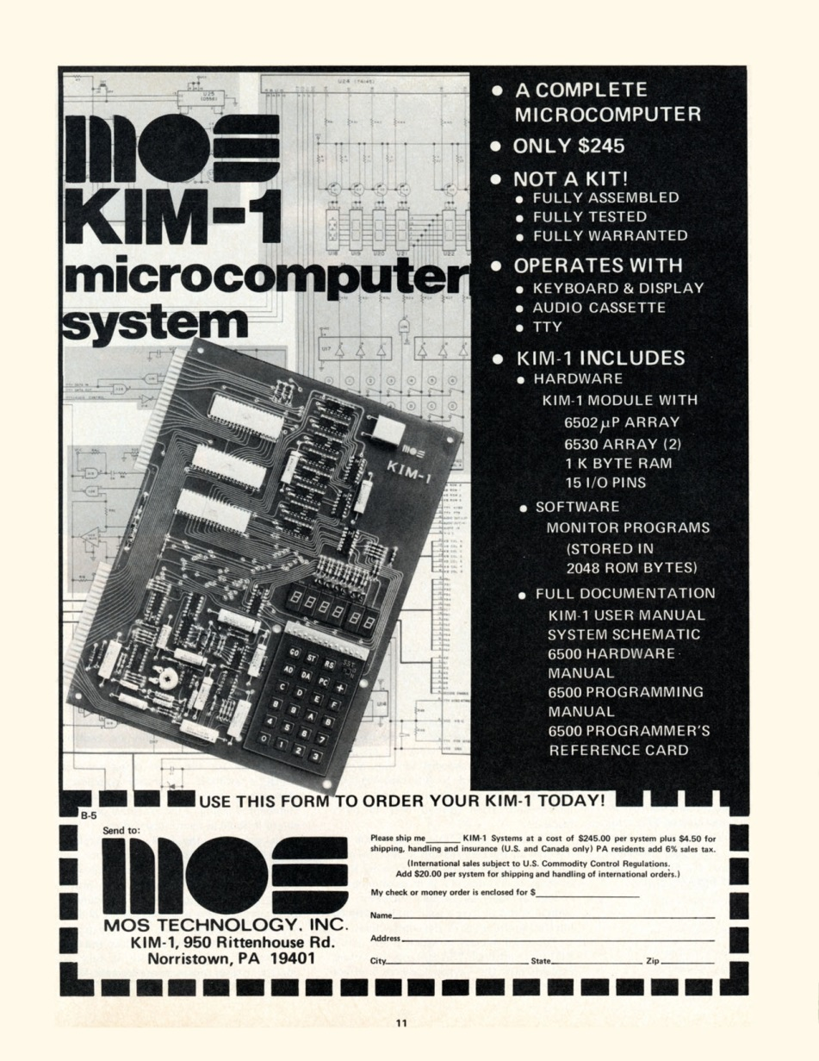
Technology in Marketing
Firms use online channels to track and monitor consumer activities.
Firms are shifting spending from traditional media to the Web because of its ability to:
Track customers
Analyze campaign results
Modify tactics
Firms are using apps to develop location-based messages and services and for cashless payment.
Firms are using social media to:
Generate sales
Improve their reputations
Better serve customers

Slide 33
Technology-centric Operations
Quality programs
Process redesign
Supply chain management
Factory automation
Service operations

Slide 34
Technology in Human Resources
Knowledge management systems are transforming into social media technologies.
Helps in organizing and leveraging teams of experts.
Technology is used for employee training, screening, and evaluation.
Recruiting has moved online.
Grounded in information systems that search databases for specific skill sets.
Job seekers write resumes with key words as the first cut can be made by a database search program.
Professional social networks have put added pressure on employee satisfaction and retention.
Some students with their thoughtful blog posts, compelling LinkedIn presence, and Twitter activities set themselves apart from their counterparts.

Slide 35

Technology in Law
Activity has increased in the areas of intellectual property, patents, piracy, and privacy.
Firms need legal teams with the skills to:
Determine whether a firm can legally do what it plans.
Help them protect proprietary methods and content.
Help enforce claims in the home country and abroad.

Slide 36
Six Components of a Computer-Based Information System
Hardware
Software
Data/DB
Network
Processes
People

Slide 37
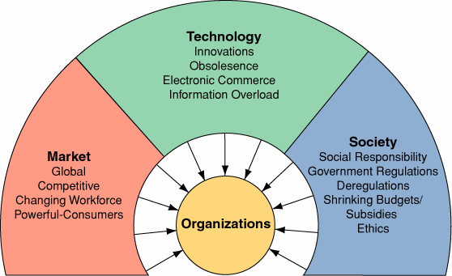
3 Types of Business Pressures
Technology
Market
Society

Slide 38
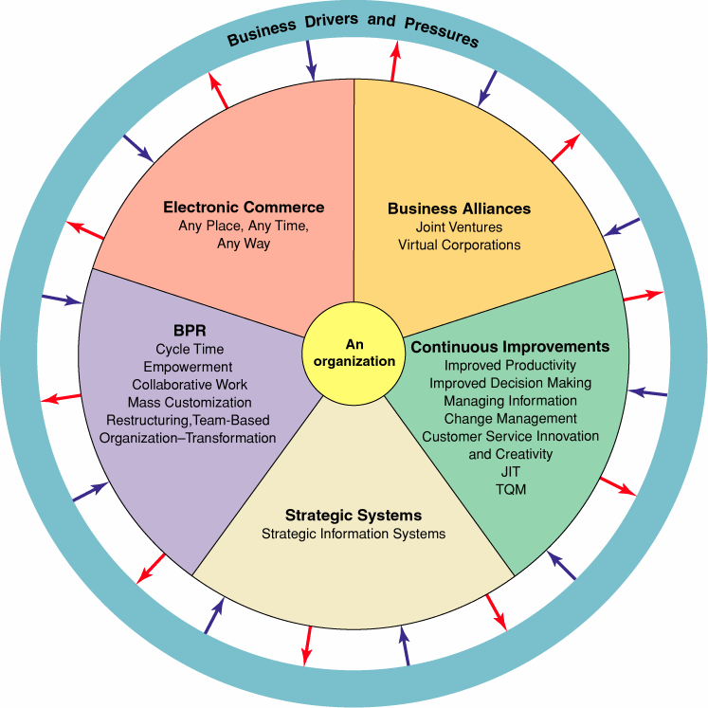
Organizational Response to Business Drivers & Pressures
Strategic Management & Systems
Continuous Improvement – Operational Efficiency
Restructuring business processes
Manufacturer to order,
Mass-Customization
Customer Focus Strategy
Electronic business
Business Alliances
Technology is required to effectively implement these critical responses.
Notes:
These are solutions to problems that result from business pressures

Slide 39
Chapter 2
Strategy and Technology: Concepts and Frameworks for Understanding What Separates Winners from Losers

Slide 40
Learning Objectives
Define operational effectiveness and understand the limitations of technology-based competition leveraging this principle.
Define strategic positioning and the importance of grounding competitive advantage in this concept.
Understand the resource-based view of competitive advantage.
List the four characteristics of a resource that might possibly yield sustainable competitive advantage.

Slide 41
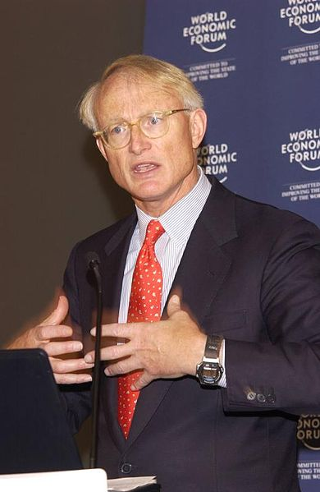
Dangers of Relying on Technology
Michael Porter’s concepts are useful for firms attempting to achieve comparative advantage:
Value chain
Five forces
Porter states that firms defining themselves according to operational effectiveness suffer aggressive, margin-eroding competition.
Operational effectiveness: Performing the same tasks better than rivals.
The danger lies in similarity and failure to innovate. When offerings are roughly the same, they are more commodity.

Slide 42

Dangers of Relying on Technology
Fast follower problem exists when competitors:
Watch a pioneer’s efforts.
Learn from their successes and missteps.
Enter the market quickly with a comparable or superior product at a lower cost before the first mover can dominate.
Because technology can be matched quickly, firms that pioneer in technology are especially susceptible to this problem.

Slide 43

Technology and Strategic Positioning
Strategic positioning: Performing different activities than rivals, or the same activities in a different way.
Technology should create and enable novel business approaches that are defensibly different and can be difficult for others to copy.
E.g., The FreshDirect model:
Provides innovations such as:
Worker shifts are highly efficient.
Firm buys and prepares its own goods.
Higher inventory turns (number of times inventory is sold or used during a given period).
Use of artificial intelligence and climate-controlled rooms.
In exchange, they receive more favorable supplier terms with stores:
Sharing data to improve supplier sales and operations
Paying in days rather than in weeks

Slide 44
Resource-Based View of Competitive Advantage
To maintain sustainable competitive advantage, a firm must control a set of exploitable resources that has four critical characteristics:
Valuable
Rare
Imperfectly imitable
Nonsubstitutable
Resource-based thinking helps to avoid entering markets simply because growth is spotted.

Slide 45
Learning Objectives
Understand that technology is often critical to enabling competitive advantage, and provide examples of firms that have used technology to organize for sustained competitive advantage.
Understand the value chain concept and be able to examine and compare how various firms organize to bring products and services to market.
Recognize the role technology can play in crafting an imitation-resistant value chain, as well as when technology choice may render potentially strategic assets less effective.
Define the following concepts: brand, scale, data and switching cost assets, differentiation, network effects, and distribution channels.
Understand and provide examples of how technology can be used to create or strengthen the resources mentioned above.

Slide 46

Powerful Resources
Being aware of major sources of competitive advantage can help managers:
Recognize an organization’s opportunities and vulnerabilities.
Brainstorm winning strategies.
Firms with an effective strategic position can create assets that reinforce one another.
Creates advantages that are difficult for rivals to successfully challenge.

Slide 47
Imitation-Resistant Value Chains
A Way of doing business that competitors struggle to replicate and that involves technology in a key enabling role
Value chain: Set of activities through which a product or service is created and delivered to customers.
For example, elements in FreshDirect’s value chain work together to create and reinforce competitive advantages that others cannot easily copy.

Slide 48
The Value Chain
Inbound Logistics
Operations
Outbound Logistics
Marketing and Sales
Service
Assisted by the secondary elements of:
Infrastructure
Human Resources
Technology
Procurement

Slide 49
Porter Value Chain

Slide 50
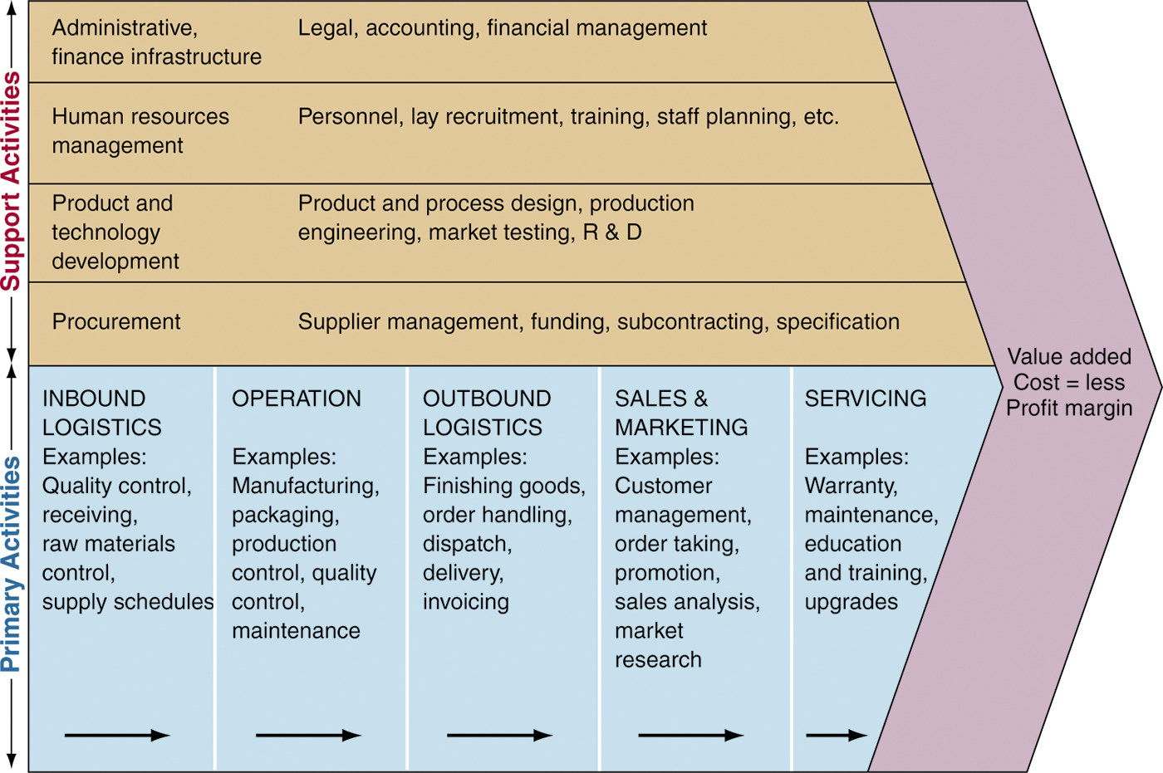
Porter Value Chain Diagram
The firm’s value chain. The arrows illustrate the flow of goods & services (the internal part of the supply chain). (Source: Drawn by E. Turban)
Notes:
Facilitate discussion about the importance of activities in each category. Students bring examples from various industries.

Slide 51
Extended Value Chain
Includes suppliers and customers
Strategic opportunities for suppliers
Strategic opportunities for customers

Slide 52
Extended Value Chain or Ecosystem
Suppliers
Electronic Manuf. Services
Company
Channel
Customers
Semi-conductor
Apple Stores
Consumer
Apple
Foxconn
Displays
Carriers (AT&T, Verizon)
Enterprise
Flextronics
SW
Resellers
Gov’t

Slide 53
Brand
The Symbolic embodiment of all the information connected with a product or service
A strong brand can be an exceptionally powerful resource for competitive advantage.
Consumers use brands to decide which company’s products are better, thus forming brand loyalty.
Technology helps in rapidly and cost-effectively strengthening a brand.
Viral marketing: Leveraging the enthusiasm of consumers to promote a product or service

Slide 54
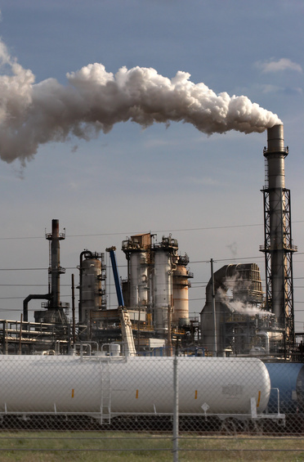
Scale advantages
Businesses benefit from economies of scale: Costs can be spread across increasing units of production or in serving multiple customers.
Organizations are scalable if they benefit from scale economies as they develop.
Developing firms may gain bargaining power with their suppliers or buyers.

Slide 55
Switching Costs
Costs incurred by consumers when switching from one product to another
Firms that seem dominant but that do not have high switching costs can be rapidly outshined by strong rivals.
Sources:
Learning costs
Information and data
Contractual commitments
Search costs
Loyalty programs

Slide 56



Differentiation
Technology is used by firms to differentiate their wares.
Data plays a critical role in differentiation.
Commodities: products or services that are nearly identically offered from multiple vendors (e.g., gold, wheat).

Slide 57

Network Effects
When the value of a product or service increases as its number of users expands.
Referred to as network externalities or Metcalfe’s Law.
Switching costs play a role in determining the strength of network effects.
Strong asset for firms that can control and leverage a leading standard.
Notes:
Exponential factor
Creates a winner take all situation

Slide 58
Distribution Channels
Path through which products or services get to customers
Through networked technology, users can be recruited to create new distribution channels.
Affiliates: Third parties that promote a product or service in exchange for a cut of any sales.

Slide 59
Patents
Grant protection for intellectual properties; Applicable to innovations deemed to be useful, novel, and nonobvious
Patents provide firms a degree of protection from copycats.
Cut off paths to exploit an innovation.
Considered to be unfairly stacked against start-ups.
Notes:
It is hard to get a patent in computer science
It is hard to patent an algorithm

Slide 60
Learning Objectives
Diagram the five forces of competitive advantage.
Apply the framework to an industry, assessing the competitive landscape and the role of technology in influencing the relative power of buyers, suppliers, competitors, and alternatives.

Slide 61
The Five Forces of Industry Competitive Analysis
Rivalry among existing competitors
Potential new entrants
Power of buyers
Threat of substitutes
Power of suppliers

Slide 62
Porter Five Forces of Competition
Suppliers
Industry
Competitors
Potential
Entrants
Substitutes
Buyers
Notes:
Classic diagram of Porters Five Forces

Slide 63
Suppliers
HW Components
SW Components
Semiconductors
Optoelectronics
Power of Suppliers is Med
Comm. Equip.
Industry
Competiveness is
High
Potential
Entrants
Comp HW OEMs
New Chinese Manuf
Power of Entrants
is Medium
Industry
Competitors
Cisco, Ericsson, Huawei,
Alcatel-Lucent, Juniper
Power of Industry Comp
is Hi
Substitutes
Power of Substitutes
is Lo
Buyers
Carriers: AT&T, Verizon, China Telcom
Enterprises: Google, Apple, GE, IBM
Power of Buyers is Hi

Slide 64
Porter Five Forces of Competition Analysis
If overall competitive forces are high, then the industry is not very profitable
Conversely, if overall competitive forces are low, then the industry is profitable
Standards tend to increase competition, therefore lower profitability

Slide 65
Managing IT Resources Next Week Assignments
Work with Team on selecting Client and Project Topics
Read Chapter 5 in Gallaugher Text: Moore’s Law and More prior to Class on Sept 10
Read Chapter 6 in Gallaugher Text: Disruptive Technologies prior to Class on Sept 10
Read the Current Events articles posted on LMS prior to Class on Sept 10
Be prepared to take Quiz on readings at beginning of Class on Sept 10
Review Cost-Benefit Analysis Examples on LMS
Each Team submit Term Project Proposal by EOD 11:59 pm on Thur Sept 13

